Slide 1
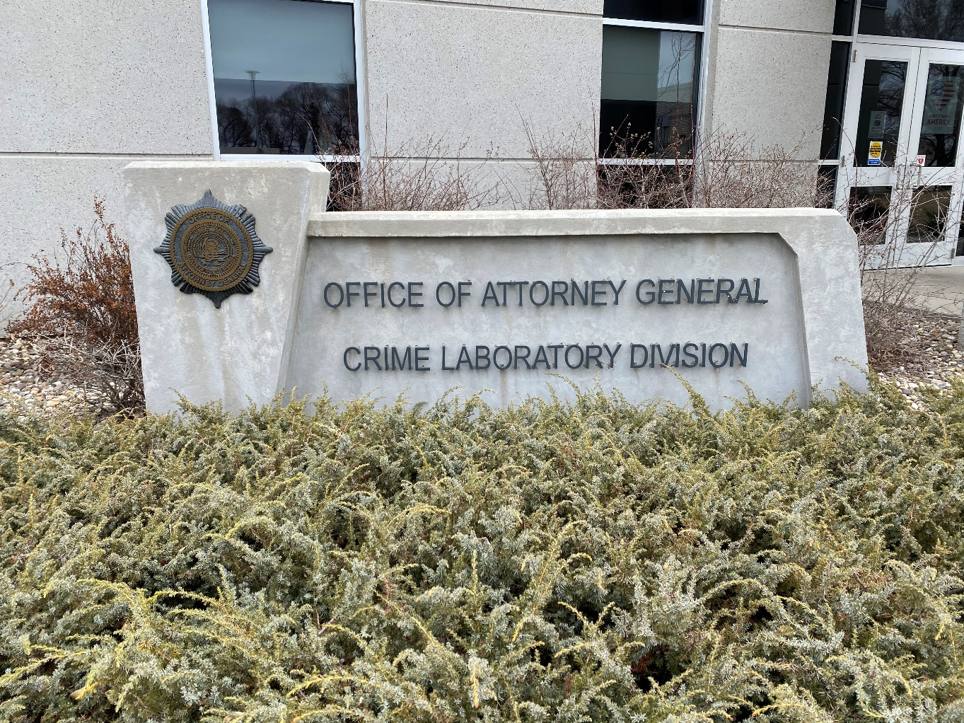
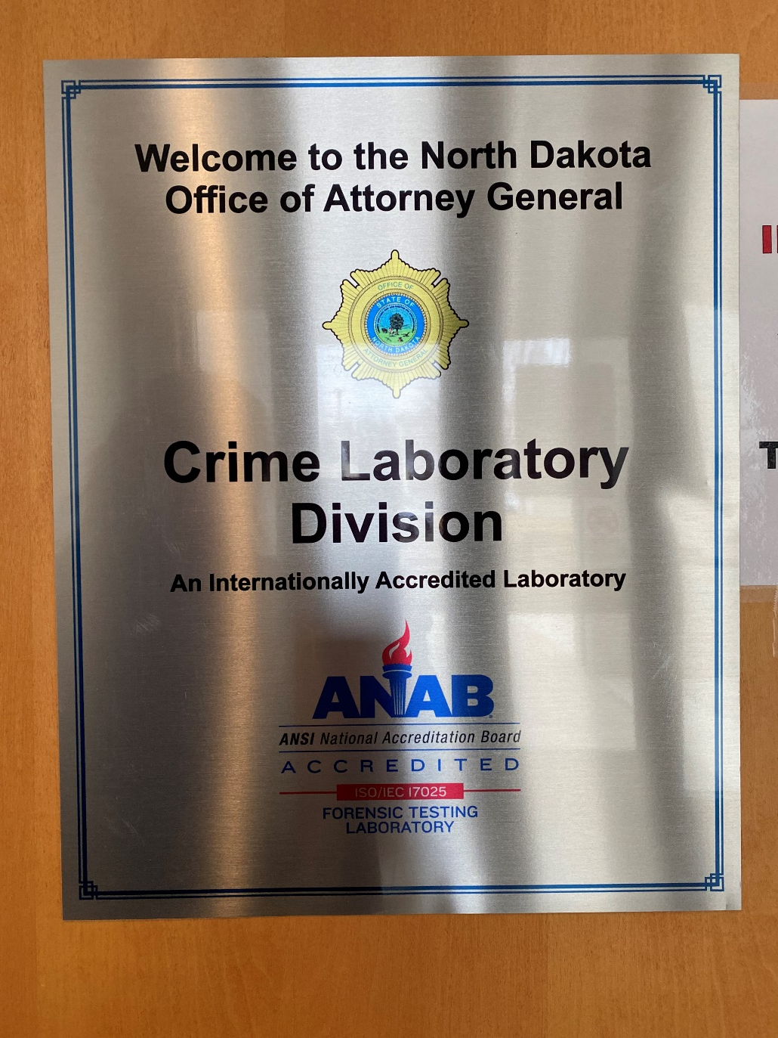
“Everything You Need to Know About the CLD"
June 23, 2021

Slide 2
NDOAG-CLD is an Internationally Accredited Laboratory

Slide 3
Notes:
Management System responsibilities: personnel (education & training); validations; analysis of results; review of results; reporting

Slide 4
ANAB Reassessment & FBI Quality Assurance Standards Audit (Casework and Database) February 16 – 19, 2021 (REMOTE)
We were assessed to over 1000 Standards (ISO and FBI) and had ZERO Findings in both FBI QAS Audit Documents (first EXTERNAL audit using the new (July 2020) FBI QAS Documents) and 4 Nonconformities for ISO 17025:2017.
2 of the NCs are “paper fixes” and 2 require us to purchase calibrated glassware and calculate Measurement Uncertainty for Meth quants (FCU).
Number of Standards Assessed to:
ISO 17025:2017: 203
ANAB AR 3125: 75
FBI QAS CW: ~438
FBI QAS DB: ~404
Notes:
~$5K spent on calibrated glassware in addition to time of personnel to calculate MU – results showed that there was no significant change in MU using calibrated glassware (+/- 4.0% to +/-4.6% (UV-Vis) and +/-7.5% to +/- 7.8% (GC/MS)

Slide 5
ACCREDITED LABORATORY SERVICES
Discipline: Biology
Component/Parameter of Characteristic Tested:
● DNA – STR
● DNA – YSTR
● Body Fluid Identification
● Relationship Testing
● Individual Characteristic Database (CODIS)
Discipline: Seized Drugs
Component/Parameter of Characteristic Tested:
● Qualitative Determination
● Quantitative Determination
● Weight Measurement
Discipline: Fire Debris
Component/Parameter of Characteristic Tested:
● Qualitative Determination
Discipline: Toxicology
Component/Parameter of Characteristic Tested:
● Qualitative Determination
● Quantitative Determination

Slide 6
NON-ACCREDITED LABORATORY SERVICES
Breath Alcohol Program
● Certification and Maintenance of Breath Alcohol Equipment
● Training of Operators of Breath Alcohol Equipment
● Archiving Breath Alcohol records
REMOVED from SCOPE of ACCREDITATION – February 2021
Discipline: Friction Ridge
Component/Parameter of Characteristic Tested:
● Enhancement
● Physical Comparison
● Individual Characteristic Database (ABIS)

Slide 7
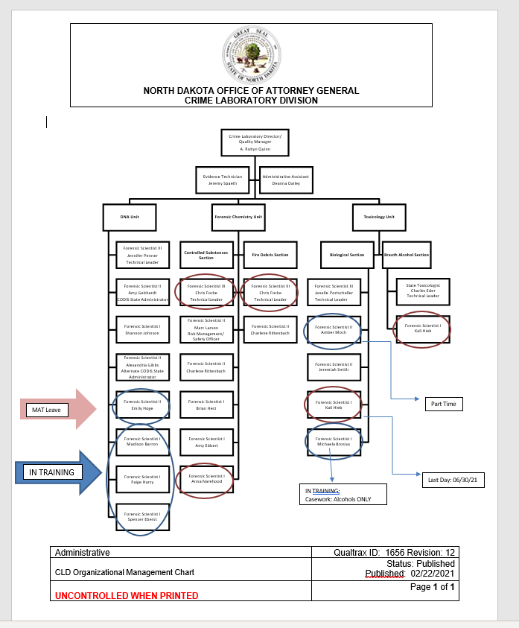
Notes:
DNA Unit: 3 in training (2 authorized to screen; 1 probation extended); 1 – MAT Leave FCU: 2 resignations in March 2021; 1 – MAT Leave = 3 FS – analysis and reviews
Hiring: finite pool of candidates due to specialty of Forensics and specific requirements (ISO and FBI QAS)

Slide 8
Changes in internal and external issues that are relevant to the CLD
DNA Unit:
July 24, 2020: Resignation of Stephanie Maier
August 27, 2020: Resignation of Kyle Splichal
September 4, 2020: Swopnil Parajuli’s last day (probationary release)
New Hires
Madison Barron: October 19, 2020
Spencer Eberst: November 16, 2020 (Probation extended to September 2021)
Paige Harsy: November 16, 2020
Angel Stanhope (Administrative Assistant – TEMP – SAFE-ITR Grant): Hired September 14, 2020 – Quit February 16, 2021
Forensic Chemistry Unit:
September 22, 2020 – Anna Narehood removed from casework for retraining. Returned to casework on November 24, 2020.
December 28, 2020 – March 2, 2021: Amy Ebbert – Maternity Leave
March 5, 2021: Resignation of Chris Focke (Technical Leader)
March 2021: Resignation of Anna Narehood
NOTE: As per ISO 17025:2017 a Discipline MUST have two qualified Forensic Scientists in order to release results. The CLD will be contracting Chris to perform technical reviews of Fire Debris cases until Amy Ebbert has completed her Fire Debris analysis training and is qualified. The CLD also performs analysis of Fire Debris analysis for South Dakota.
Charlene Rittenbach has been promoted to Technical Leader of the FCU. Part Time Hours (Maternity Leave) through August 2021.
Latent Print Unit:
January 29, 2021: Resignation of Dan Haak. Friction Ridge discipline removed from ANAB Scope of Accreditation on February 1, 2021
Toxicology Unit – Biological Section:
September 23, 2019: Start date – Michaela Brosius (Probation extended twice)
Kali Hieb: Last day at the CLD: June 30, 2021
Notes:
DNA Unit – July and August 2020: resignation of TWO interpreting DNA Analysts; September 2020: probationary release of trainee FCU: FS taken off of casework; 1 – MAT Leave January 2021: resignation of LPE

Slide 9
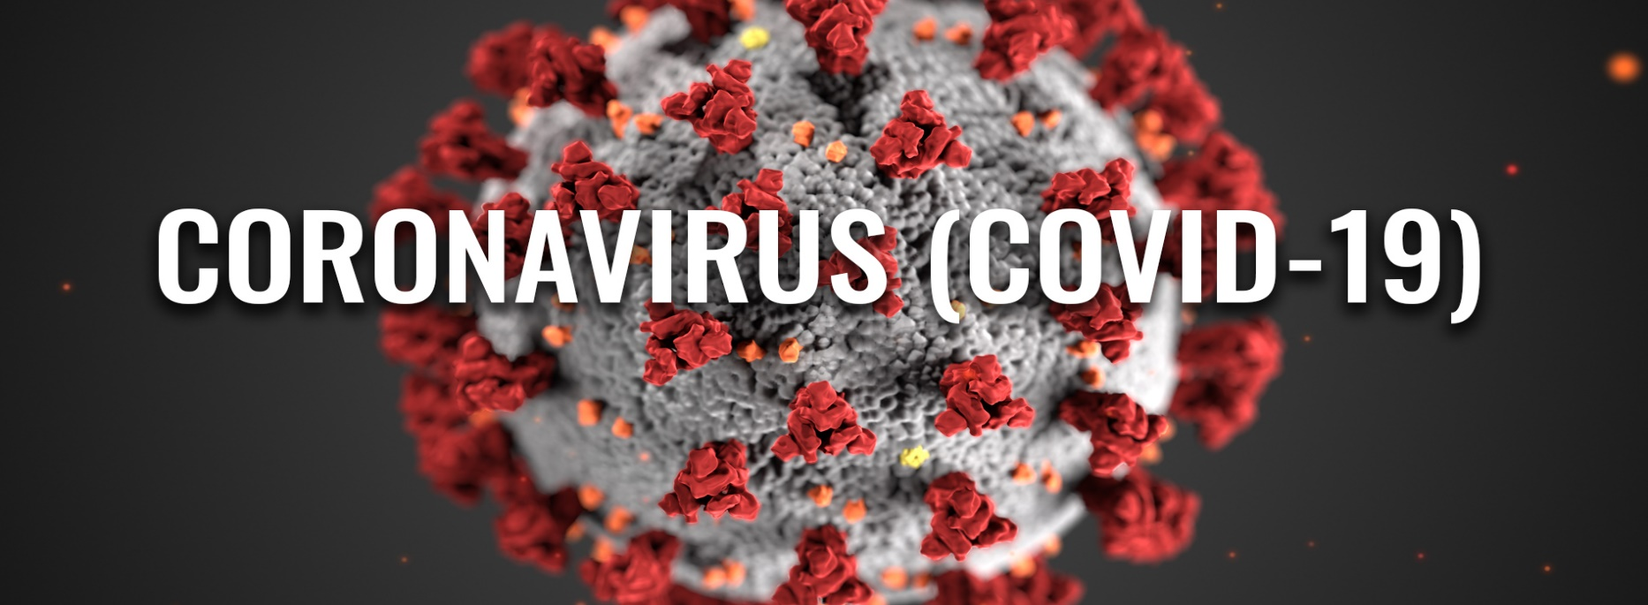
Anna Narehood: OUT 10/15/20 -10/22/20
Jeremiah Smith: OUT 10/27/20 – 11/20/20; 01/23/21 – 01/26/21
Marc Larson: OUT 11/03/20 – 11/17/20
Jeremy Spaeth: OUT 11/18/20 – 11/27/20
Michaela Brosius: OUT 11/30/20 -12/01/20
Amy Ebbert: OUT 12/21/20 – 12/28/20
Brian Herz: OUT 12/21/20 – 01/04/21
Dan Haak: COVID-19 Emergency Sick Leave (4 hours weekly: 05/05/20 – 12/31/20)
Dan Haak: OUT 12/28/20 – 01/02/21
Shannon Johnson: COVID-19 Emergency Sick Leave (126 hours: 04/01/20 – 05/29/20)
Amber Moch: COVID-19 Emergency Sick Leave (126 hours: 04/01/20 – 05/29/20)
Allie Gibbs: Worked remotely – April 1 – 30, 2020

Slide 10
TRAINING PROGRAM
6.2.2.2 The training program for each function influencing the results of laboratory activities, to the extent necessary based on job function, shall include:
a) the knowledge, skills, and abilities needed to perform work;
b) general knowledge of forensic science;
c) the application of ethical practices in forensic science;
d) criminal law, civil law, and testimony;
e) provisions for retraining;
f) provisions for maintenance of skills and expertise; and
g) criteria for acceptable performance
6.2.3.1 All personnel who perform testing or calibration shall be competency tested. Testing or calibration includes the review and authorization of results and expressing an opinion or an interpretation. The competency test shall include practical examination(s) that cover the spectrum of anticipated tasks related to the test or calibration. The competency test intended results shall be achieved prior to performing the tasks on a test or calibration item.
Notes:
6 – 12 months depending on experience and competency

Slide 11
EDUCATION REQUIREMENTS
Notes:
DNA – additional requirements: Molecular Biology, Biochemistry, Genetics and Statistics; TL must have Masters Degree and 3 years of experience in a DNA Laboratory

Slide 12
ISO/IEC 17025:2017
7.2.2 Validation of methods
7.2.2.1 The laboratory shall validate non-standard methods, laboratory-developed methods and standard methods used outside their intended scope or otherwise modified. The validation shall be as extensive as is necessary to meet the needs of the given application or field of application.
NOTE 1 Validation can include procedures for sampling, handling and transportation of test or calibration items.
NOTE 2 The techniques used for method validation can be one of, or a combination of, the following:
a) calibration or evaluation of bias and precision using reference standards or reference materials;
b) systematic assessment of the factors influencing the result;
c) testing method robustness through variation of controlled parameters, such as incubator temperature, volume dispensed;
d) comparison of results achieved with other validated methods;
e) interlaboratory comparisons;
f) evaluation of measurement uncertainty of the results based on an understanding of the theoretical principles of the method and practical experience of the performance of the sampling or test method.
7.2.2.2 When changes are made to a validated method, the influence of such changes shall be determined and where they are found to affect the original validation, a new method validation shall be performed.
7.2.2.3 The performance characteristics of validated methods, as assessed for the intended use, shall be relevant to the customers' needs and consistent with specified requirements.
NOTE Performance characteristics can include, but are not limited to, measurement range, accuracy, measurement uncertainty of the results, limit of detection, limit of quantification, selectivity of the method, linearity, repeatability or reproducibility, robustness against external influences or cross-sensitivity against interference from the matrix of the sample or test object, and bias.

Slide 13
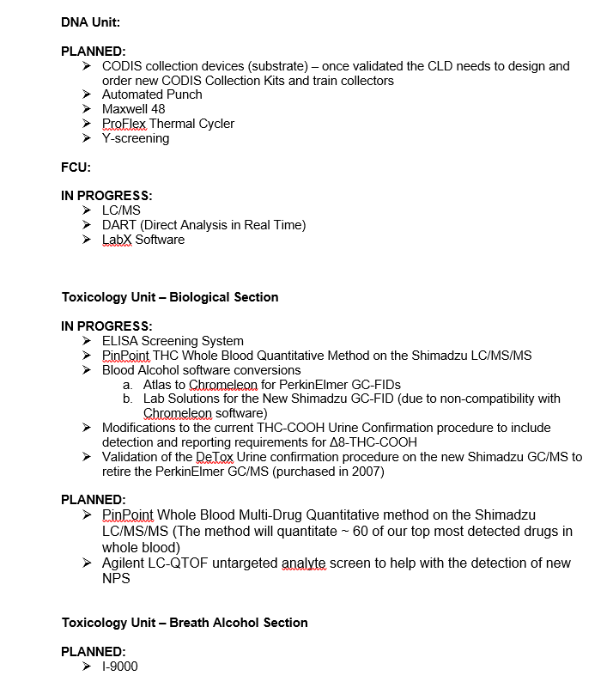
VALIDATIONS

Slide 14
ISO/IEC 17025:2017 PROFICIENCY TESTING
7.7 Ensuring the validity of results
7.7.1 The laboratory shall have a procedure for monitoring the validity of results. The resulting data shall be recorded in such a way that trends are detectable and, where practicable, statistical techniques shall be applied to review the results. This monitoring shall be planned and reviewed and shall include, where appropriate, but not be limited to:
use of reference materials or quality control materials;
use of alternative instrumentation that has been calibrated to provide traceable results;
functional check(s) of measuring and testing equipment;
use of check or working standards with control charts, where applicable;
intermediate checks on measuring equipment;
replicate tests or calibrations using the same or different methods;
retesting or recalibration of retained items;
correlation of results for different characteristics of an item;
review of reported results;
intralaboratory comparisons;
testing of blind sample(s).
7.7.2 The laboratory shall monitor its performance by comparison with results of other laboratories, where available and appropriate. This monitoring shall be planned and reviewed and shall include, but not be limited to, either or both of the following:
participation in proficiency testing;
participation in interlaboratory comparisons other than proficiency testing.
Notes:
DNA: twice a year (per kit – GlobalFiler, Fusion, Yfiler, Paternity, CODIS and mixtures); Other disciplines: once per year
WHY WE ARE ACCREDITED… ROBUST QUALITY MANAGEMENT SYSTEM; COMPETENT SCIENTISTS; REPRODUCIBLE RESULTS

Slide 15
Forensic Laboratories are an important part of our judicial process. Their purpose is to scientifically analyze and preserve evidence of crimes. Done right, forensic scientists help exclude the innocent and convict the guilty. Done wrong, innocent people are convicted of crimes they didn’t commit.

Slide 16
Forensic Laboratory Scandals
CA
FBI
MA
In 2010, a lab tech was found to have been using cocaine that she said had spilled in the lab, and had also taken cocaine from a colleague’s locker in the lab.
21 empty vials were found in the tech’s home.
11 evidence samples were found to have been tampered with in the lab.
An investigation found the defense attorneys were not told of the lab tech’s criminal past and that the work of the lab was slipshod. All of this is important to the tech’s credibility when testifying in court.
San Francisco Weekly, Jaxon Van Derbeken, April 14, 2010
In 2015, the FBI acknowledged 26 of 28 forensic hair examiners overstated matches in a manner favoring the prosecution. They did so in 95% of 268 trials.
The cases included 32 cases where the defendant was sentenced to death.
At the time of the FBI’s acknowledgement, 14 defendants had died in prison or been executed.
Washington Post, Spencer S. Hsu, April 18, 2015
The Boston Herald reported that a former chemist at the state crime lab had been using drug evidence to feed her habit and had even cooked crack-cocaine in the lab for her use.
When arrested, the chemist admitted to smoking crack in the lab after hours or during overtime hours and even before testifying in court in cases in which she had tested the drugs.
Boston Herald, Matt Stout May 3, 2016

Slide 17
TX
CO
DC (most recent – 2021)
A review of procedures of a crime lab in Austin, Texas, determined DNA analysts were not adequately trained and did not adhere to nationally recognized best practices in handling DNA evidence.
Analysts who brought their concerns to management were ignored.
The analysts were using outdated statistical models to process DNA samples taken from crime scenes.
A second study of Texas crime labs found that of 302 prisoners who were exonerated, 142 had been convicted in part due to inaccurate or misleading forensic evidence.
Austin American Statesman,
Eric Dexheimer Jan. 12, 2017
In 2017, it was found that the certifications for the breath machines, the Intoxilyzer 9000, were being forged.
The signatures on the certifications were those of a lab director who hadn’t worked at CDPHE since 2015. Mike Barnhill, a former employee at CDPHE, told the Denver Post that in 2013 the Department was in a rush to begin using the new Intoxilyzer 9000. The Department brought in a lawyer and a marketing specialist from the company who made the machines to certify them.
Lawyers in Weld county got 33 DUI cases dismissed because the Intoxilyzer 9000 used in the cases was recording inaccurate blood alcohol levels.
Denver Post, Noelle Phillips March 15, 2017
The report, commissioned by D.C. Attorney General Karl Racine, concluded that the lab erroneously connected cartridge casings from two 2015 killings to the same gun, and later misrepresented the mistake to two national accreditation boards.
The ANSI National Accreditation Board suspended the D.C. Department of Forensic Science's accreditation over the weekend, and details of the suspension letter now state that the board has "credible evidence" that the lab has "deliberately concealed information from the ANAB assessment team, violated accreditation requirements, engaged in misrepresentations and fraudulent behavior, and engaged in conduct that brings ANAB into disrepute.“
In April, the lab lost its accreditation to perform forensic testing services. Last week, the department’s director, Dr. Jenifer Smith, resigned and D.C. Mayor Muriel Bowser, in a letter Friday, told the D.C. Council the city was hiring an outside consultant “to conduct a complete assessment of the agency.”
The lab also remains the subject of an ongoing criminal investigation being carried out by the D.C. Office of the Inspector General into how lab managers responded to the discovery of errors in the McLeod case.

Slide 18
When injustices occur in criminal cases, our institutions — prosecutors, police departments, crime laboratories — often treat it as a “bad apple” problem.
Institutions blame the individual and fail to look within the institution for the root cause.
We are starting to recognize that the actions of “bad apples” are often rooted in systems that fail to account for cognitive bias, shoddy casework, institutional culture, and perverse incentives for employees and managers.
Though popular television shows associate crime labs with science and accuracy, all too often, quality control systems in real-world crime labs are too weak to identify mistakes and fraud, and management is unable or unwilling to address institutional shortcomings.
When this happens, innocent people go to prison.

Slide 19
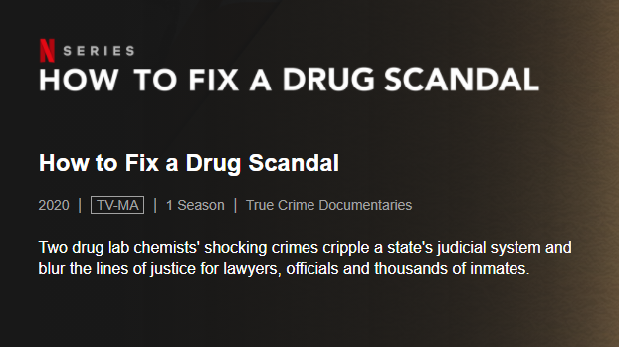
https://www.netflix.com/title/80233339

Slide 20
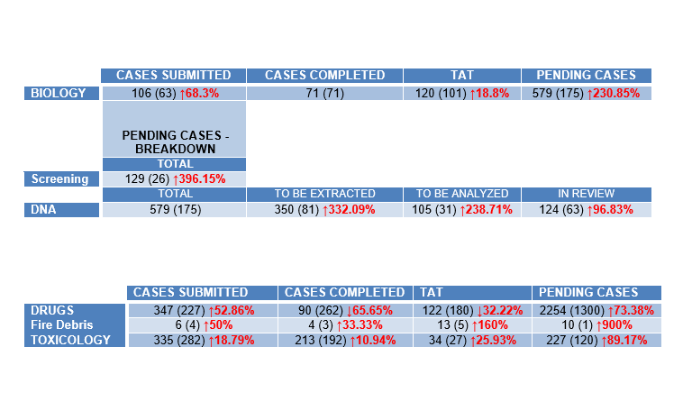
MAY 2020 vs. MAY 2021 Crime Laboratory Division Statistics
Notes:
Loss of personnel = increased pending cases; increased number of cases in review due to losing 2 interpreting analysts

Slide 21
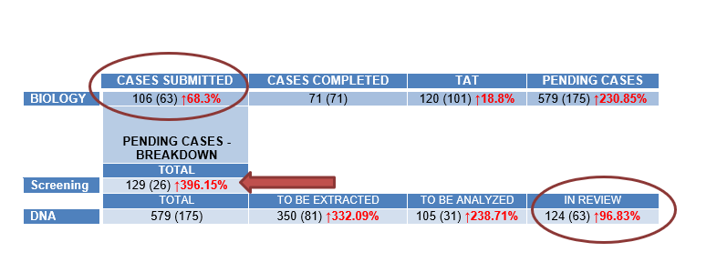
DNA Unit

Slide 23
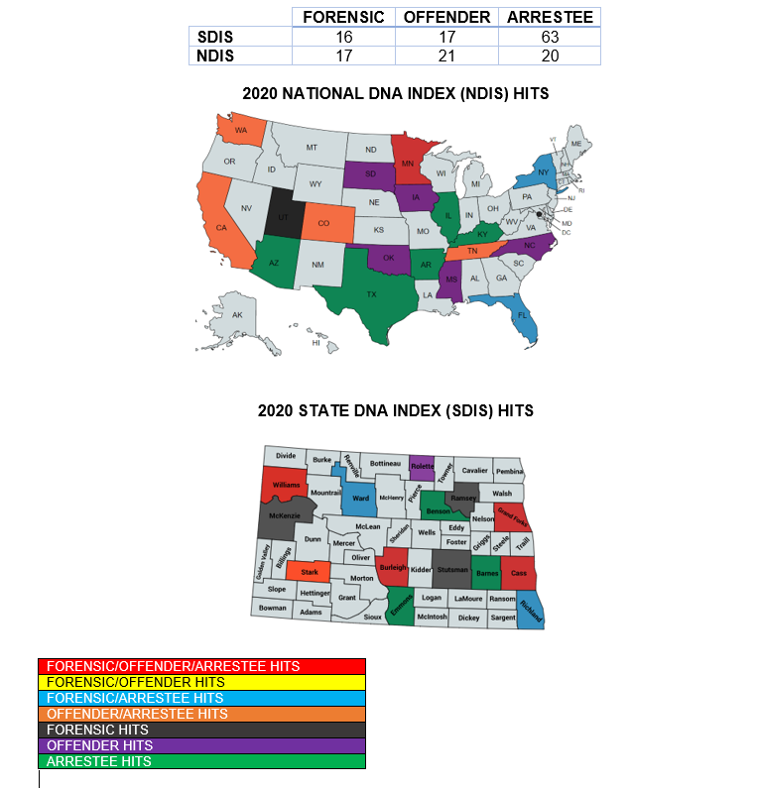
Notes:
154 CODIS Hits – confirmation process

Slide 24
FORENSIC CHEMISTRY UNIT
Notes:
# Cases completed decreased due to loss of personnel, including 1 FS being taken off of casework; TAT decreased due to prioritizations (calculation of TAT) BUT cases completed decreased by 66%

Slide 25
Seized Drug Case Example
14 June 21
Prioritization Request received (Burleigh County)
15 June 21
Analysis started
(30 Items; 6 Subjects)
17 June 21
Calls/emails asking for results; subpoena received (court date: week of 06/21/21; Case technically reviewed
18 June 21
Case released; notified that case was continued
Notes:
ABOVE AND BEYOND

Slide 26
ABOVE AND BEYOND

Slide 27
TOXICOLOGY UNIT – BIOLOGICAL SECTION
Notes:
Instrument issues; validation of new instruments and methods; Paternity Leave; COVID; PT personnel

Slide 28
FEDERAL GRANTS
CLD Responsibilities:
Semi-Annual and Annual Progress Reports
Program Metrics
Must meet requirements of solicitation
Purchase approved supplies, consumables, training, et al and monitor approved budget
Coverdell 2019 – end date: 12/31/21
Coverdell 2020 – end date: 12/31/21
DNA 2018 – end date: 12/31/20
DNA 2019 - end date: 12/31/21
DNA 2020 - end date: 09/30/22
DOT FY21 - end date: 09/30/21
SAFE-ITR – end date: 12/31/23
(HB 2281)
Task 1: SAK Inventory – COMPLETED
Task 2: Purchase, install and implement SAK Tracking software (includes training users); barcode newly designed SAKs/FME Forms and distribute to collection agencies – IN PROGRESS
Task 3: Report and track results
Notes:
Federal funding used to purchase instruments, consumables, kits, training

Slide 29
HOT TOPICS
Notes:
Prioritizations; subpoenas, testimony; terminating cases

Slide 30
FCU Case Prioritizations
“Top 5” Requests:
Burleigh: 35%
Cass: 25%
Morton: 10%
Grand Forks: 20%
Ward: 10%

Slide 31
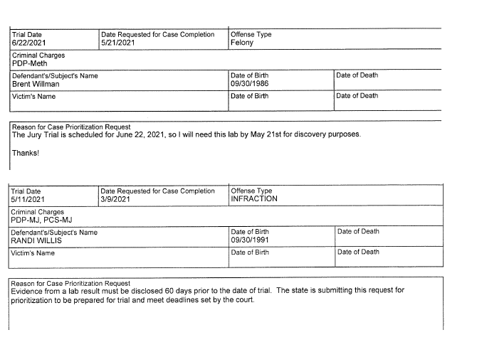
Differences within the Same Agency
30 days
60 days

Slide 32
SUBPOENAS
► Generic (CLD Analyst)
► Block off: multiple days/week
► Evidence Technician

Slide 33
SUBPOENAS – Breath Alcohol
► Foundational Documents can be found at https://attorneygeneral.nd.gov/alcoholtoxicology-testing
► The CLD trains & certifies Intoxilizer Users; inspects Intoxilizer instruments
► CLD personnel DO NOT operate the Intoxilizers in the field; therefore can only testify to the foundational documents

Slide 34
TESTIMONY
Issues:
► Stipulation to Reports not requested or denied
► Video testimony not requested or denied
Results:
► CLD personnel are out of the laboratory for hours/days
► Backlogs increase

Slide 35
July 1, 2019 – March 10, 2021 Zoom Testimony: 1 Phone Testimony: 1 Average time out of CLD: 8 hours Average time of testimony: 22 minutes

Slide 36
EXAMPLES
Ward County: Infraction Charge; Pro Se Defendant; Bench Trial; No questions: Out of office – 5 hours
Cass County: No questions from Defense: Out of office – 11 hours
Cass County: Out of Office – 1.5 days (testimony: 30 minutes)
Cass County: Out of office – 13.5 hours (testimony: 20 minutes)
Nelson County: Out of office – 13 hours (testimony: 20 minutes; no questions from Defense)

Slide 37
Terminated Cases (FCU)
Cass County is the only SA’s Office that contacts the CLD on a regular basis to indicate cases that can be terminated (sent back to LEA without analysis).
# of Terminated Cases (majority queried by CLD FCU personnel prior to beginning analysis):
2018: 705
2019: 909
2020: 1510 (691 Controlled Substances cases were TERMINATED by the CLD (January 1, 2020 – March 4, 2020) based on ND Courts information.
2021: 498

Slide 38
Prioritization Scheme
Notify the CLD ASAP when analysis not needed
Limit the number of items submitted for analysis
Stipulate to Report/testify via IVN

Slide 40
