Slide 1
DUI 101
The Mistakes I’ve Made and You Can Avoid

Slide 2
Getting Started

Slide 3
Its all about the checklists
Law Enforcement
Prosecutors
Vehicle in Motion
Personal Contact
Pre-Arrest Screening
Chemical Testing
Basis for “stop”
Complete investigation
Valid test
All evidence available
All evidence handed over to defense

Slide 4
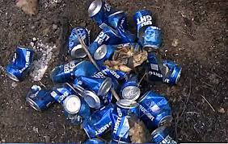
“I Only Had Two Beers”
Two Beers Manual

Slide 5
How impaired are they?

Slide 6
Field Sobriety Testing
Non-standardized
Standardized
Alphabet
Partial Alphabet
Count Backwards
Finger Touch
HGN
Walk and Turn
One Leg Stand
SFST Videos

Slide 7
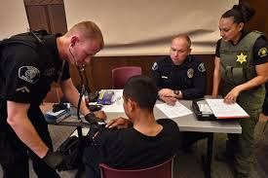
The DRE

Slide 8
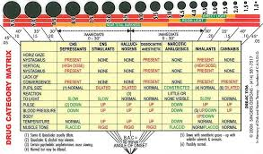
Two Beers Manual - Chapter 5
DRE Course Participant Manual

Slide 9
Getting the Chemical Test Admitted
Traditional Method
“Short Cut” Method
Call all the witnesses needed to establish the foundation necessary to get the test admitted – person who drew blood, testing officer, forensic analyst, state toxicologist, etc.
Offer the “foundation” documents as authorized by N.D.C.C. § 39-20-07
Provide notice as required by N.D.R.Evid. 707

Slide 10
N.D.R.Evid. 707
RULE 707. ANALYTICAL REPORT ADMISSION; CONFRONTATION Effective Date: 3/1/2014
(a) Notification to Defendant. If the prosecution intends to introduce an analytical report issued under N.D.C.C. chs. 19-03.1, 19-03.2, 19-03.4, 20.1-13.1, 20.1-15, 39-06.2, or 39-20 in a criminal trial, it must notify the defendant or the defendant's attorney in writing of its intent to introduce the report and must also serve a copy of the report on the defendant or the defendant's attorney at least 60 days before the date set for the trial.
(b) Objection. At least 45 days before the date set for the trial, the defendant may object in writing to the introduction of the report and identify by name or job title a person who made a testimonial statement in the report to be produced to testify about the report at trial. If objection is made, the prosecutor must produce the person requested. If the witness is not available to testify, the court must grant a continuance.
(c) Extension. The court may modify any of the deadlines under this rule on a showing of good cause.
(d) Waiver. If the defendant does not timely object to the introduction of the report, the defendant's right to confront the person who prepared the report is waived.
(e) Juvenile Proceedings. This procedure applies to juvenile proceedings that involve analytical reports issued under N.D.C.C. chs. 19-03.1, 19-03.2, 19-03.4, 20.1-13.1, 20.1-15, 39-06.2, or 39-20.

Slide 11
Rule 707 requires the prosecution to notify a defendant if it intends to introduce an analytical report in a criminal trial. If the defendant objects to the admission of the report, the defendant must identify the witness it seeks to examine about the report at trial and the prosecution must produce the witness.
Some examples of analytical reports include: a certified copy of an analytical report of a blood, urine, or saliva sample from the director of the state crime laboratory or the director's designee; a certified copy of the checklist and test records from a certified breath test operator; or a certified copy of an analytical report signed by the director of the state crime laboratory or the director's designee of the results of the analytical findings involving the analysis of a controlled substance or sample.
Subdivision (a) was amended, effective March 1, 2014, to require the prosecution to serve a copy of the analytical report on the defendant at least 60 days before the date set for trial.
Subdivision (b) was amended, effective March 1, 2014, to require the defendant to object to introduction of the report at trial at least 45 days before the date set for trial. The subdivision was also amended to clarify that, if the defendant requests a person to testify about the report at trial, the person must be someone who made a testimonial statement in the report.
Subdivision (c) was added, effective March 1, 2014, to give the court discretion to modify the rule's deadlines.
Under North Dakota law, if the person who prepared the report does not testify at trial, a certified copy of an analytical report must be accepted as prima facie evidence of the results of a chemical analysis. See N.D.C.C. §§ 19-03.1-37(4), 20.1-13.1-10(6), 20.1-15-11(8), 39-20-07(8), and 39-24.1-08(6).

Slide 12
Rule 707 Case Law
State, ex rel. Roseland v. Herauf, 2012 ND 151 – the nurse’s affidavit is a testimonial statement
State v. Lutz, 2012 ND 156 – under Rule 707, the person who draws blood is subject to cross-examination but the person who prepared the volatiles solution is not
State, ex rel. Madden v. Rustad, 2012 ND 242 – under Rule 707, the director is not subject to cross-examination
City of Grafton v. Wosick, 2013 ND 74 – the Rule 707 notice requirements are not necessary if the defense can cross-examine the relevant witnesses
City of West Fargo v. Olson, 2020 ND 188 – field inspector report not testimonial

Slide 13
What problems are prosecutors facing with Rule 707?
Discussion Topic:

Slide 14
Back to my checklists

Slide 15
Foundation Documents
Intoxilyzer

Slide 16
Foundation Documents
Blood for Alcohol

Slide 17
Foundation Documents
Blood for Drugs

Slide 18
Foundation Documents
Urine for Drugs

Slide 19
Discovery – again with the checklists
Need to get it all and need to send it all
Foundation documents – depends on the jurisdiction when send it
Attorney General - Alcohol/Toxicology Testing

Slide 20
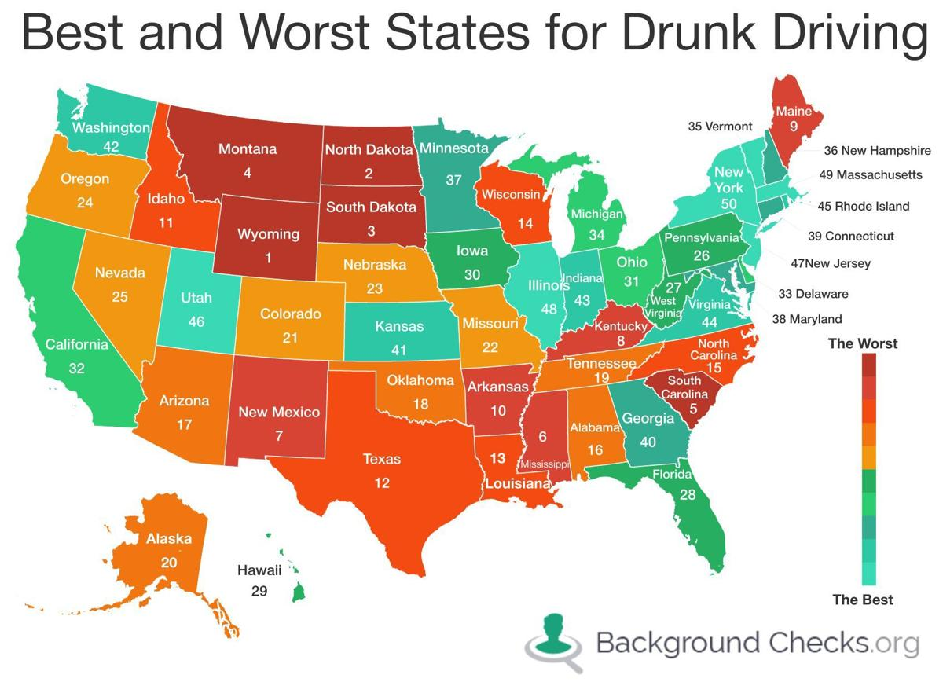
Why we do this
28 people die every day in car crashes involving drunk drivers
One-third of all traffic crash fatalities in the U.S. involve drunk drivers
In N.D. there is one alcohol-related vehicle fatality every 9 days
In N.D. there were 402 motor vehicle injuries involving alcohol in 2019

Slide 21
Questions & Comments
What works for you?

Slide 22
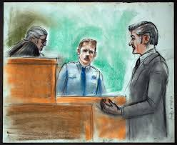
Kristi Pettit Venhuizen
kpettit@kalashpettitlaw.com
Office: 701.780.9276

